Slide 1
AGENTIC AI
Cleaning Analytics Reporting INtelligence Agent(CARINA)
From Manual Data Analysis to AI-Driven Data Analysis
Current State → Future State → Business Impact
Data Cleansing
Analytics
Intelligent Reporting & Strategy

Slide 2
FUTURE STATE — SOLUTION OVERVIEW
Business Benefits
Improve driver allocation (reduce idle time)
Reduce customer wait time
Dynamic pricing opportunities & Reduce Operation Cost
Send more taxis to peak zones during peak hours → more trips per driver. Reduce over‑supply in low‑demand areas → increase fleet efficiency.
Predictive dispatching → faster pickups → improved customer satisfaction → more repeat customers.
Identify high‑demand periods where surge pricing increases revenue
Governed, observable, and reusable across every team — no custom infrastructure required.
Notes:
Identify high‑demand periods where surge pricing increases revenue

Slide 3
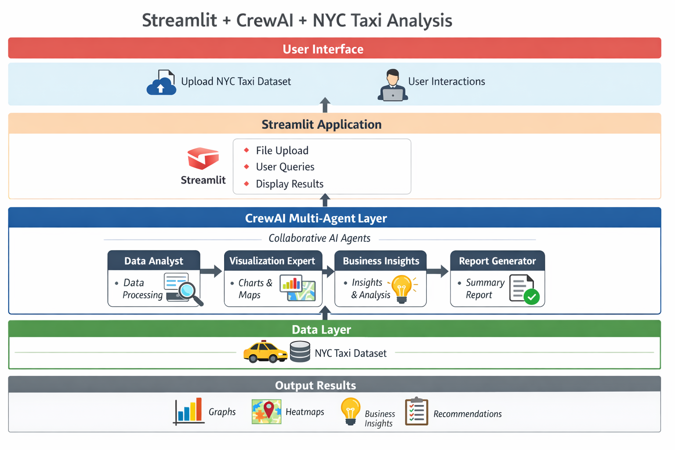
Data Cleansing
Analytics
Intelligent Reporting & Strategy

